Slide 1
Automation 1: a
rule-based workflow
What can a workflow of plain rules do for my messages, and where does it stop?
Applied AI and Automation | Session 6 of 12
KLAi Professional Learning | Jotham Martin Wambi
Notes:
Welcome. Today is a demonstration, and nobody builds anything. I show you an automation made only of plain rules, running on the same twelve customer messages you met in Session 1. The results are recorded in advance, so we spend our time on what they mean. First, three questions from Session 5.
The question for today is this: What can a workflow of plain rules do for my messages, and where does it stop? Keep it in mind. At the end of the session we come back to it and see how much more you can say.

Slide 2



Today in one view: what you will leave with
By the end of today you will have
The four parts of any automation: trigger, rules, route and log
The exact result of a rule router on twelve customer messages, and what a policy rule fixes and breaks
Five controls to ask for before you trust any automation
Notes:
Here is what you leave with today. You can name the four parts of any automation. You know the exact result of a rule router on twelve messages, including what a payment rule fixes and what it breaks. And you hold a list of five controls to ask for before you trust any automation, yours or a vendor’s.

Slide 3
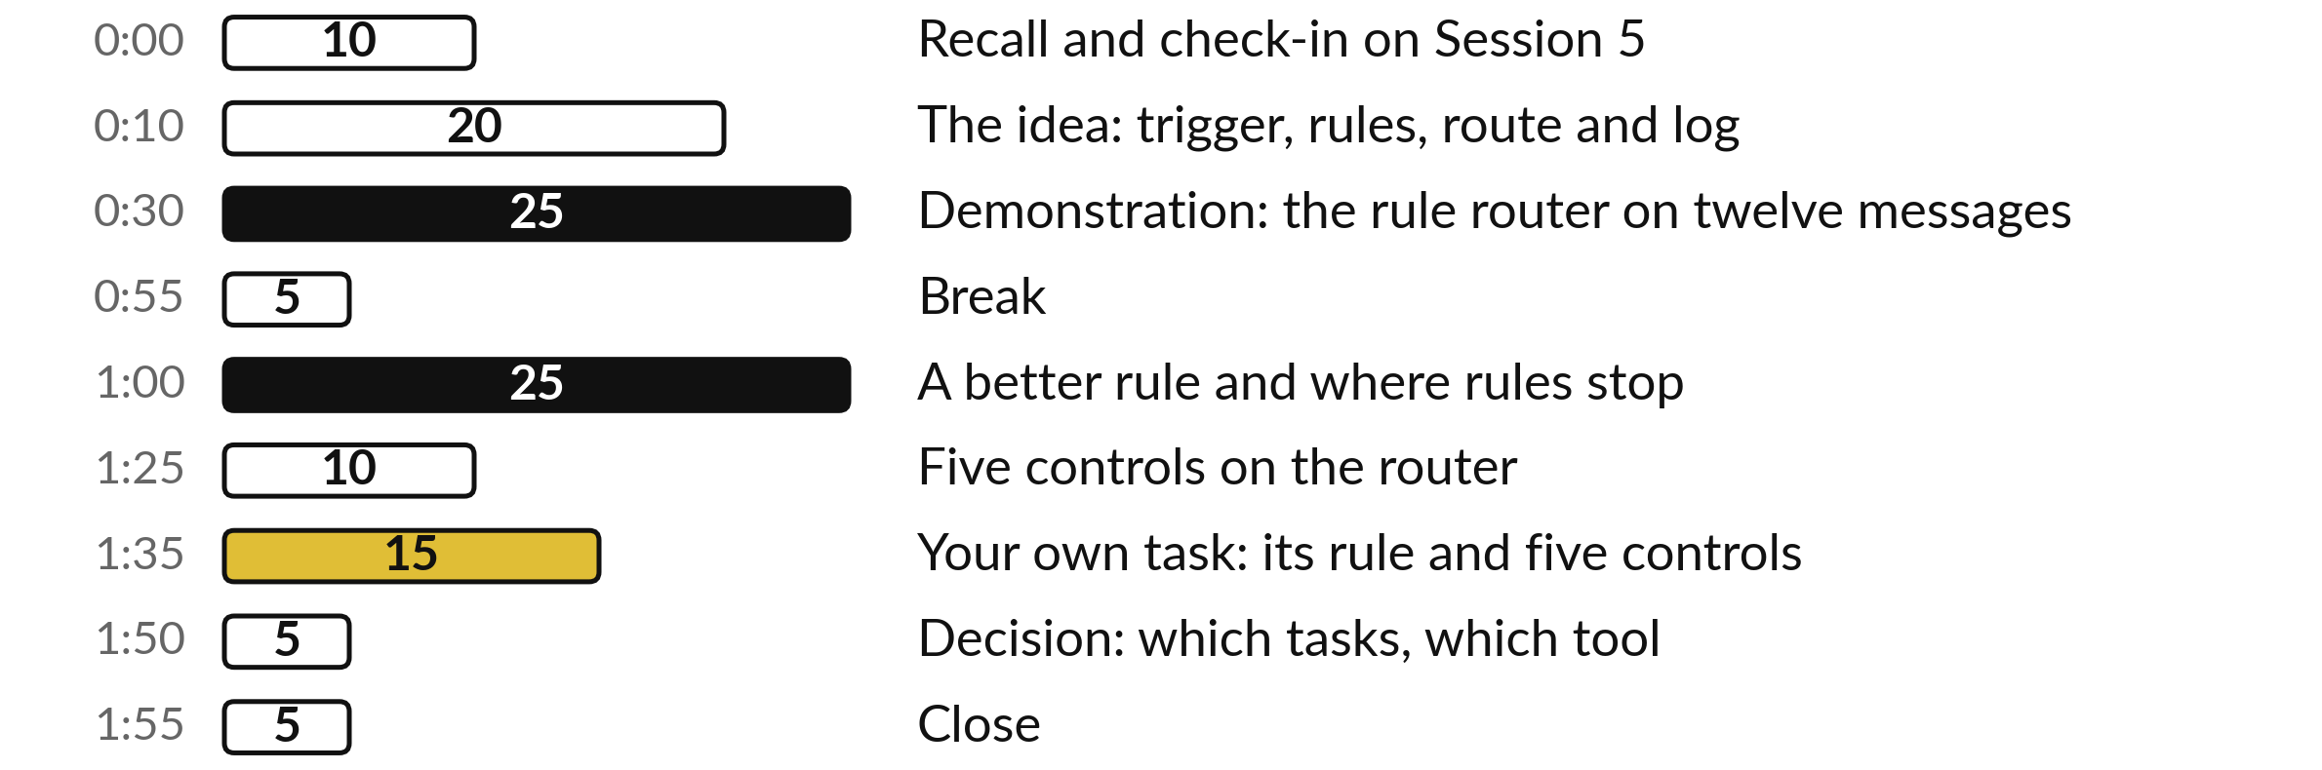
Your two hours: mostly a
demonstration, then your own task
This is a demonstration: 15 of the 120 minutes are about your own task.
Notes:
Mostly I show and you watch. Twenty minutes for the four parts of an automation, then twenty-five for the router on the twelve messages. After the break I add a payment rule and show what it fixes and what it breaks, then ten minutes on the five controls.
The last twenty-five are yours: fifteen to write a rule and its five controls for your own task, then a short decision and the close.

Slide 4

Three questions from last time
1. In the agreement review, what was the agreement compared with, and what did each flag need?
2. Why is shortlisting CVs with AI a risk, and who decides?
3. What did the meeting notes have to become before they were useful?
Answer aloud first. Then we check together.
Notes:
Three quick questions from Session 5. Answer aloud first, and then we check together. It is a warm-up to bring last time back.
Question one. In the agreement review, what was the agreement compared with, and what did each flag need? Take a moment.
A good answer is this. It was compared with the company’s own review playbook, which says what the company will and will not accept. Each flag needs a quote from the agreement so a person can check it.
Question two. Why is shortlisting CVs with AI a risk, and who decides? Say it to yourself first.
A good answer is this. The AI gives fluent reasons that can hide bias, and it can slip on a detail such as a date count: run 1 counted two years for 2023 to present. A person decides, with the criteria written first.
Question three. What did the meeting notes have to become before they were useful? Think about your own task as you answer.
A good answer is this. A list of decisions and actions, each with an owner and a date, checked against the notes.
If an answer was missing, your own task card or last workbook page has it. Now to today.

Slide 5




Words we use today
Word | What it means
Automation | A set of steps that runs by itself when something happens, with no person starting each run.
Trigger | The event that starts an automation, such as a new row of messages in a sheet.
Rule | A fixed test on the data, for example: the text contains the word late.
Route | Sending the message to a queue, which is the list one team works from.
Log | A record of each run: what came in, which rule fired and where it went.
Notes:
Five words for today. I give the plain meaning of each, and we use every one of them before the end of the session.
Automation. A set of steps that runs by itself when something happens, with no person starting each run.
Trigger. The event that starts an automation, such as a new row of messages in a sheet.
Rule. A fixed test on the data, for example: the text contains the word late.
Route. Sending the message to a queue, which is the list one team works from.
Log. A record of each run: what came in, which rule fired and where it went.

Slide 6
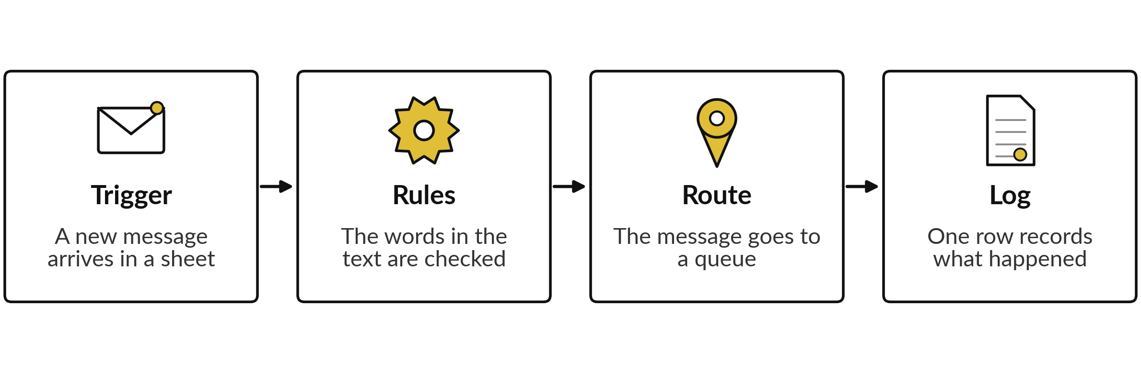
Every automation has four parts:
trigger, rules, route and log
If you can name these four parts for a task, you can judge a tool for it.
Notes:
Start with the plain idea. An automation does a job by itself when something happens. It has four parts. The trigger is the event that starts it, here a new message. The rules are fixed tests on the words. The route sends the message to the right queue, which is the list one team works from.
The log records what happened. Whatever the tool or the price, a vendor demonstration will show you these four parts. If you can name them for your own task, you can judge what you are being sold.

Slide 7
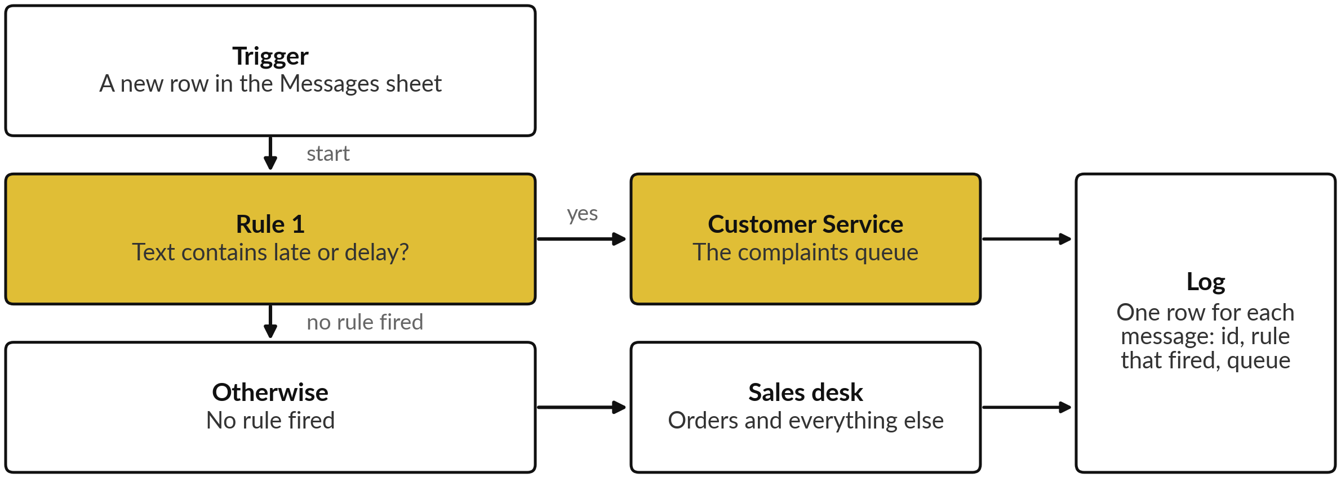
The Session 1 rule drawn as a router:
one question, two queues and a log
The Session 1 rule with a route and a log. Non-complaints go to the Sales desk for now.
Notes:
Here is the keyword rule from Session 1 drawn as a workflow. A new row of messages is the trigger. One rule asks whether the text contains late or delay. If yes, the message goes to the Customer Service queue. If no rule fires, it goes to the Sales desk, which handles orders and everything else.
Every message leaves one row in the log. For now, anything that is not a complaint goes to the Sales desk, which is a simple choice I made for the demonstration. The picture has no AI in it. Each box is a fixed test or a fixed action, so you can predict every result in advance.

Slide 8




The same logic runs in a
spreadsheet or in a no-code tool
Part | In a spreadsheet | In a no-code tool such as Zapier
Trigger | A new row of messages is pasted in | A new row or email starts a run
Rules | A formula: if the text contains late or delay | A filter or branch step with the same words
Route | A column names the queue and people filter on it | A step sends the row to that queue’s sheet or inbox
Log | Columns for the rule that fired and the queue | A step adds one row to a log sheet
Step names differ by tool and change often. I describe the logic and show no screen of any tool.
Notes:
The same four parts can live in two places. In a spreadsheet, the rule is a formula, the route is a column, and anyone can see and edit it. In a no-code automation tool, Zapier is one example and there are others, the trigger is a new row or email and the rules are a filter or a branch step.
The tool then runs by itself, without anyone opening the sheet. I am describing the logic and not showing any screen, because step names and plans change. Check what a tool offers on its own page when you need it.

Slide 9
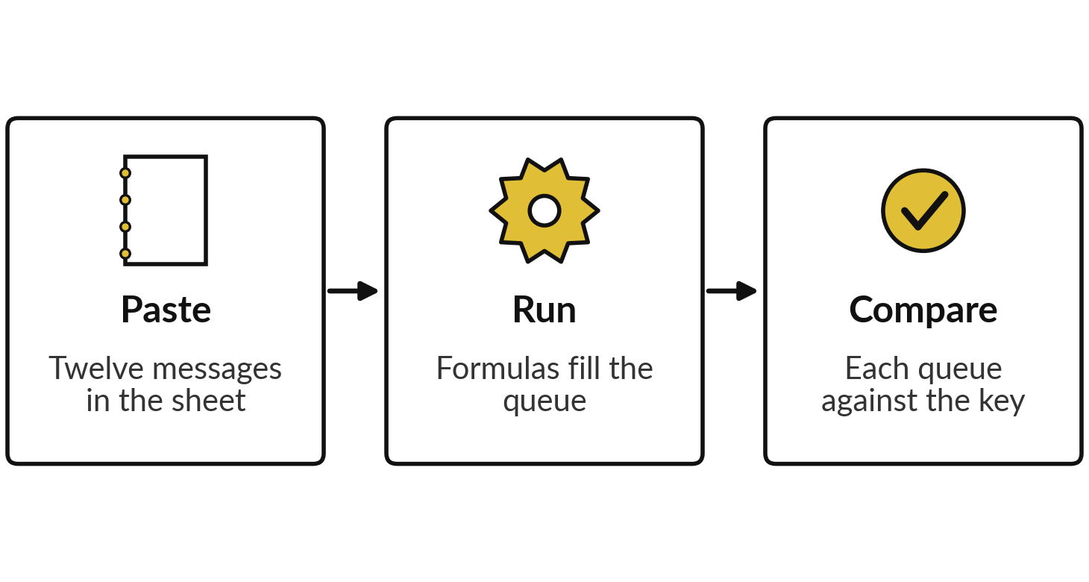
Demonstration: the rule router on twelve
messages, computed and recorded
I will show
Watch for
Which messages land in the wrong queue.
Which word caused each wrong route.
Whether the log tells you why.
Notes:
Now the demonstration. The results on the next slides are recorded: I computed them from the messages file and the answer key on the fourth of November 2026. The logic is two short formulas in a sheet, and I can show them if time allows, which is optional.
No AI ran, so every result is the same each time. Compare each queue with the key and ask two questions. Which messages went to the wrong queue?
And which word was to blame? Watch whether the log gives you enough to find out.

Slide 10
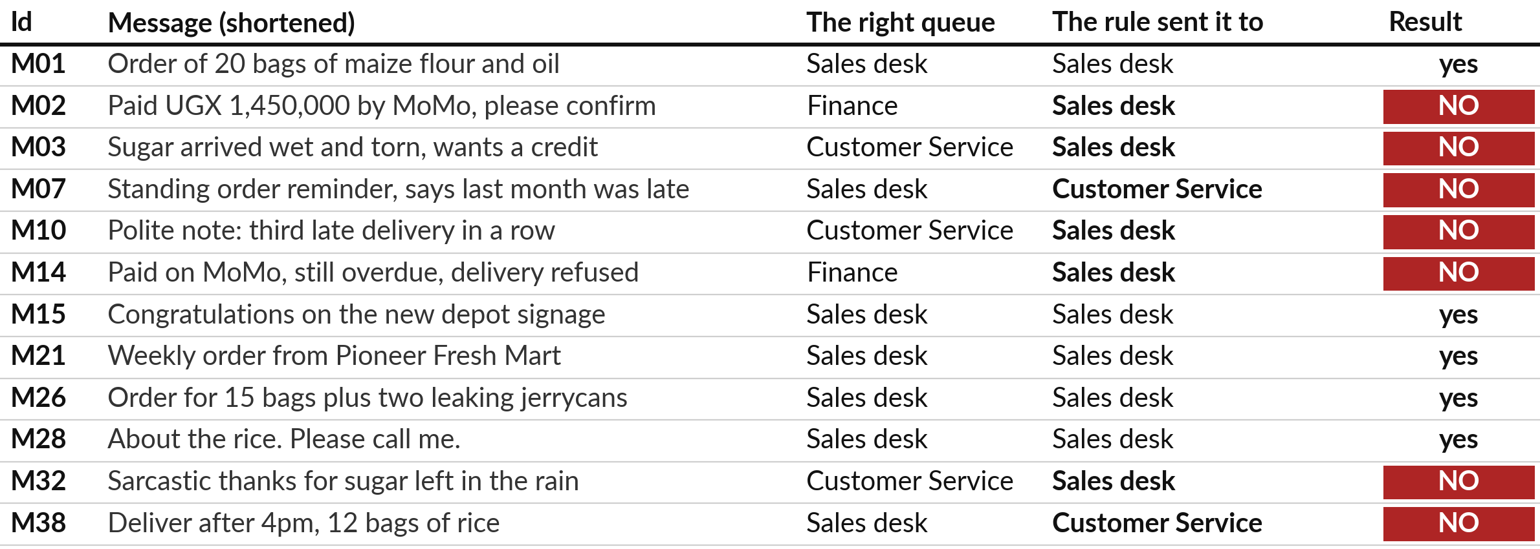
Used as a router, the complaint rule puts
5 of 12 messages in the right queue
Computed, not run. Session 1 counted only complaint or not: 7 of 12.
Notes:
Here is the router on the twelve messages. The right queue is the one the answer key implies: payments to Finance, complaints to Customer Service, orders and everything else to the Sales desk. Five of twelve land in the right queue. In Session 1 I asked only whether each message was a complaint, and the rule was right for seven.
The difference is the two payments, M02 and M14. The rule has no way to find a payment, so both go to the Sales desk. This result is computed from the files and is the same every time.

Slide 11



The 7 wrong routes come from three causes
Cause | Messages | What happened
A false alarm | M07, M38 (2) | The word late sits in a normal order, so it goes to Customer Service.
A complaint with no keyword | M03, M10, M32 (3) | Wet sugar, a polite note and a sarcastic thanks use neither word.
A payment with no payment rule | M02, M14 (2) | Both reach the Sales desk. Nothing looks for payment words yet.
On all 40 messages in the file, the rule flags only 2, both wrong, and finds none of the 9 complaints.
Notes:
Seven wrong routes, three causes. The first is a false alarm: M07 and M38 are normal orders that happen to contain the word late. The second is the complaint with no keyword: M03, M10 and M32 are complaints, but wet sugar, a polite note and a sarcastic thank you do not use our two words.
The third is a payment with no payment rule, M02 and M14. I also ran the rule on all forty messages in the file. It flags two, both wrong, and finds none of the nine complaints. Twelve messages were kind to it.

Slide 12
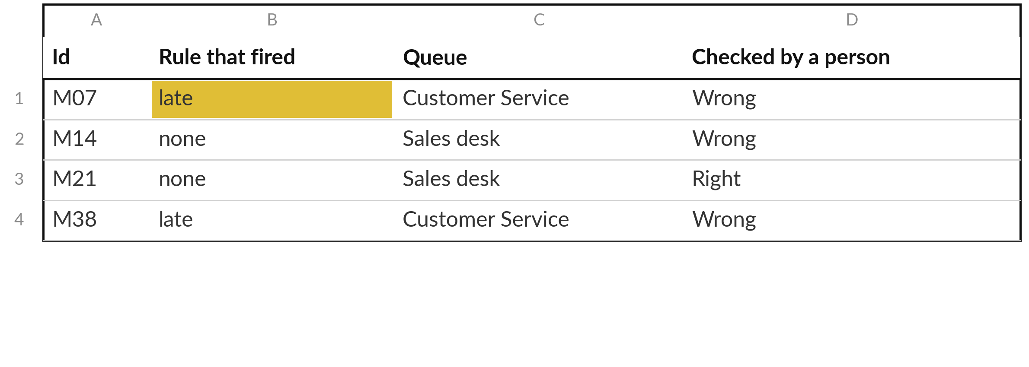
The log shows which rule sent each
message, so a wrong route can be traced
The last column is added by the person who checks the log against the key.
Notes:
This is what the log looks like, with four of the twelve rows. For each message it records the rule that fired, the queue and, once a person has checked, whether the route was right. Look at M07. The log says late fired, so you see at once why a polite order reminder landed in Customer Service.
Without a log, a wrong route is only a customer who is annoyed three days later. A log does not stop the mistake, but it tells you where to look and how often it happens.

Slide 13



Before the break: name one message in your company that
a word rule would route correctly, and one it would not
Say both aloud, with the words the rule would look for.
A message with a reliable word, such as a payment reference.
A message where meaning matters, such as a polite complaint.
Write both in your workbook.
Notes:
Before the break, I would like each of you to speak. Think of your own company. Name one kind of message or case that a word rule would route correctly, and say the words it would look for. A payment reference is a good example. Then name one where the rule would fail because meaning matters, such as a polite complaint.
Say both aloud, and write them in your workbook. I will take one answer from each of you before we stop.

Slide 14
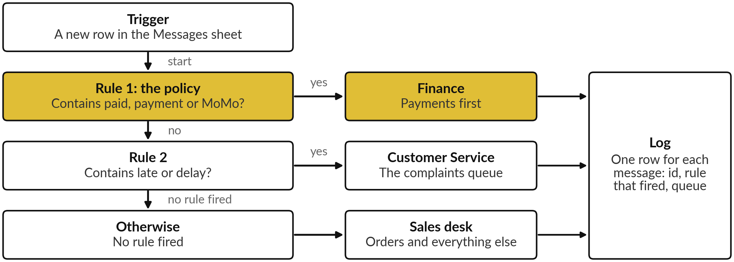
A policy becomes a rule placed
first: payment words go to Finance
The first rule that fires decides the route, so the order matters.
Notes:
Now a policy. The company says payments go to Finance first. A policy turns into a rule, and I put it above the others. If the text contains paid, payment or MoMo, the message goes to Finance and stops. Only if that rule does not fire does the late and delay rule run.
The order matters, because the first rule that fires decides the route. I chose those three words after reading the twelve messages, and that choice is a weakness I come back to. First, let me show you what it fixes.

Slide 15
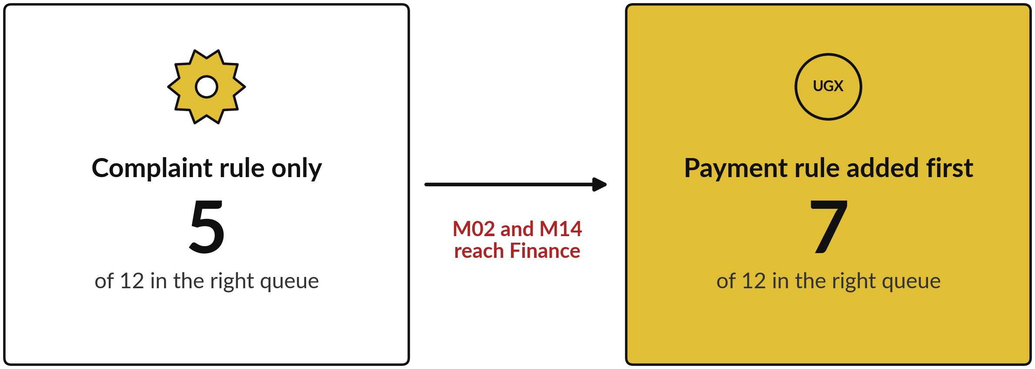
The payment rule lifts the router
from 5 to 7 of 12 in the right queue
Computed on the twelve. Five wrong routes remain: M03, M07, M10, M32, M38.
Notes:
Here is the effect, computed on the twelve messages. Before the payment rule, five of twelve land in the right queue. After it, seven. The two that moved are M02, the customer who paid by MoMo and wants confirmation, and M14, who paid and was refused a delivery.
Both now reach Finance, which is where the key says they belong. The rest is unchanged. M07 and M38 are still false alarms, and M03, M10 and M32 are still missed. One rule fixed exactly the problem it was written for, and nothing else.

Slide 16



What the payment rule breaks and leaves open
Problem | What the computation shows
One route per message | M14 and M26 each hold two topics. A rule picks one queue, so the second topic is lost.
Words picked after looking | I chose paid, payment and MoMo after reading the twelve, so 7 of 12 flatters the rule.
Payments it misses | On all 40 messages it finds 6 of the 9 payments and sends none wrongly. M08, M13 and M30 are missed.
More words, more wrong sends | Adding invoice sends M06, M23 (invoice complaints) and M37 (a lost invoice book) to Finance: 3 wrong sends, no new payment.
Notes:
Now what it breaks. First, a rule sends each message to one queue. M14 is a payment and a delivery complaint, and M26 is an order and a leak. The second topic is lost. Second, I picked the three words after reading these twelve messages, so seven of twelve flatters the rule.
On all forty messages it finds six of the nine payments and wrongly sends none, and it misses M08, M13 and M30. Third, more words do not always help. Adding the word invoice sends three messages wrongly to Finance, M06 and M23, which are invoice complaints, and M37, a lost invoice book, and it finds no new payment. A rule must be tested on messages it has not seen.

Slide 17


Rules are exact and easy to
explain, and they stop at meaning
What rules do well
Where rules stop
The same answer every time
Easy to explain to an auditor
Reliable words, such as a payment reference
Meaning: M10 and M32 pass unseen
Two topics in one message
Word lists need regular upkeep
Use rules where the words are reliable. Put a person where they are not.
Notes:
So what do rules do well?
They give the same answer every time, which makes them easy to test and easy to explain to an auditor, and they are cheap to run. They work best where the words are reliable, like a payment reference or an invoice number. Where do they stop?
They cannot read meaning, so the polite complaint and the sarcastic thank you pass unseen. They cannot hold two topics. And someone must keep the word lists up to date as customers change how they write. Use a rule where the words are reliable, and put a person where they are not.

Slide 18




Five controls every automation
needs before you trust it
An owner: one named person answers for it.
An off switch: you know where it is and who may use it.
A log: every run leaves a row you can read.
A person for exceptions: someone reads what the rules cannot place.
A test before trust: run known cases and compare with the key.
Notes:
Whatever tool or vendor you use, ask for these five controls. An owner, one named person who answers for the automation. An off switch, and you know where it is and who may use it. A log, so every run leaves a row you can read. A person for exceptions, someone who reads what the rules cannot place.
And a test before trust: run known cases and compare the result with a key before any real message goes through. If a vendor cannot show you all five, the automation is not ready.

Slide 19




The five controls for the Nile Valley
Foods router, with a question for you
Control | The message router at Nile Valley Foods | Your question
Owner | David Kato, Customer Service Lead | Who is yours?
Off switch | Turn it off. Messages are routed by hand. | Where is it?
Log | One row per message: id, rule, queue | Who reads it?
Exceptions | David reads the Sales desk queue each morning | Who would?
Test | Twelve messages against the key first | Which known cases?
Names and roles are from the fictional case company.
Notes:
Here are the five controls filled in for the Nile Valley Foods router. The owner is David Kato, the Customer Service Lead. The off switch is to turn the automation off and route by hand. The log is one row per message. David reads the Sales desk queue each morning for complaints the rules missed, which is the person for exceptions.
And the twelve messages and the key are the test. The right-hand column is for you. In the next fifteen minutes you write your own rule and these five controls.

Slide 20
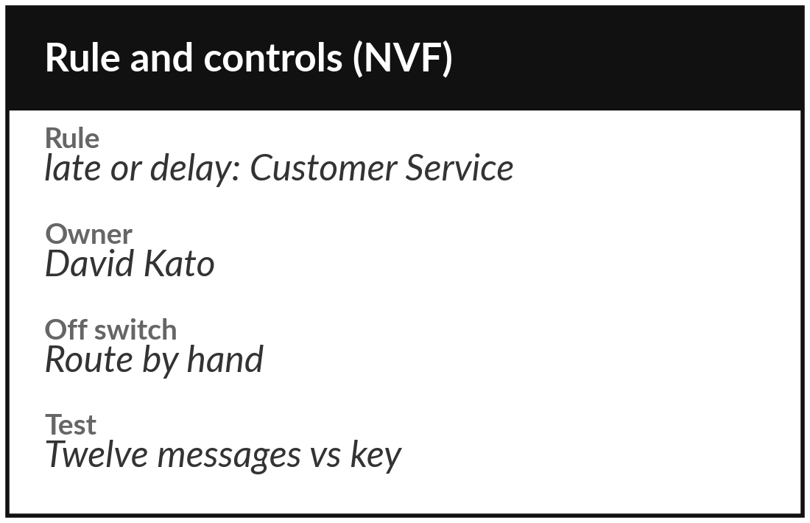
Practice: write one rule and
its five controls for your task
15 minutes
Your own company task
Write one rule and the five controls for your own task.
Name one task a word rule could route.
Write the rule in one sentence, with its words.
Name one case it would get wrong, and the cost.
Write owner, off switch, log, exceptions and test.
You keep: A workbook page: one rule and five controls with names.
Notes:
Take fifteen minutes. Use the task you chose in Session 1, or another task where a word rule could route the work. Write the rule in one sentence and the words it looks for. Name one case it would get wrong and what that wrong route would cost.
Then fill in the five controls with real names: owner, off switch, log, who reads the exceptions, and the known cases you would test first. Nothing runs today, so this is a writing exercise on your workbook page. Write short, and I walk round and read your pages with you.

Slide 21




Decision: which of your tasks
could a rule router handle?
Where does your task sit?
A rule is enough
Rules plus a person
Needs AI
Stays with a person
Fixed words and a cheap wrong route. Write the rule and the log.
Rules route and a person reads what they cannot place.
Meaning matters. Session 8 shows what AI adds and costs.
A wrong route costs too much. A person decides.
Write your task, your choice and the one rule you would start with.
Notes:
Time to decide. Take the task you chose in Session 1. Where does it sit?
A rule is enough, if the words are fixed and a wrong route is cheap. Rules plus a person, if the rules route and someone reads what they cannot place. Needs AI, if meaning matters, and that is next session. Or stays with a person, if a wrong route costs too much.
Say your choice and one reason aloud. Then write the single rule you would start with, even if you chose another option.

Slide 22
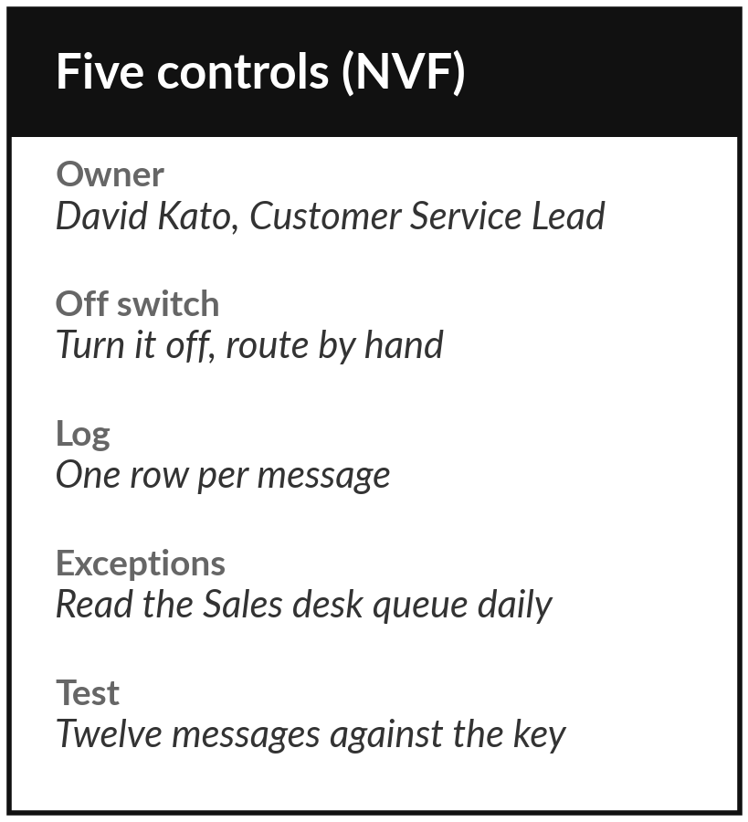
Keep your rule and its five controls, and
think about what must never run alone
What you keep from today
Your workbook page: one task of yours that a rule could route, its rule in one sentence, and the five controls with names filled in.
Our question today
What can a workflow of plain rules do for my messages, and where does it stop?
Next session
Session 7: Agents and controlled actions. Optional: write down one thing you would never let an automation do alone.
Notes:
Save your workbook page. It holds one task a rule could route, the rule in one sentence and the five controls with real names. Optional before Session 7: think of one thing you would never let an automation do alone, such as approve a payment or send a message to a customer. Session 7 is about exactly that boundary.
We began with this question: What can a workflow of plain rules do for my messages, and where does it stop? Before you go, say in one sentence what you can now say about it.

